Slide 1
Analysis SQL Project
Analyzing Real-World Inventory Data from India’s Quick-Commerce Leader

Slide 2





Project Overview
Real-world data analyst portfolio project using Zepto’s online grocery catalog
Built using actual inventory data scraped from the Zepto platform
Structured for practical SQL experience with business relevance
4. Designed for aspiring analysts and e-commerce interview preparation

Slide 3
Project Goals
Simulate how data analysts work with inventory data in retail/e-commerce
Build, clean, and query a relational database using SQL
Extract pricing, inventory, and revenue insights
Translate raw data into business decisions

Slide 4

Business Requirements
Analyze discount and pricing strategies
Identify out-of-stock high-value items
Estimate potential revenue by product category
Assess inventory distribution across SKUs
Classify products based on weight tiers for logistics use

Slide 5





Tools & Technologies
PostgreSQL
SQL database and queries
pgAdmin
Data import and query execution
Kaggle
Dataset storage & inspection
Excel / CSV
Data sourcing

Slide 6






Dataset Summary
Source: Zepto Inventory Dataset on Kaggle
Total Rows: 3,732
Columns: 9
Format: .csv
Primary Use Case: E-commerce catalog and inventory analysis
Key Columns
name, category, mrp, discountPercent, discountedSellingPrice, availableQuantity, outOfStock, weightInGms, quantity

Slide 7
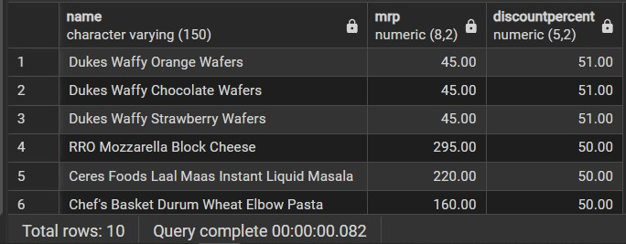
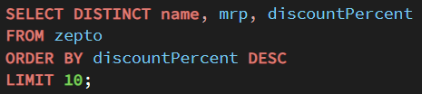
SQL Queries
Find the top 10 best-value products based on the discount percentage.
Insights: These products offer the highest discounts, great for promotions and banners.

Slide 8
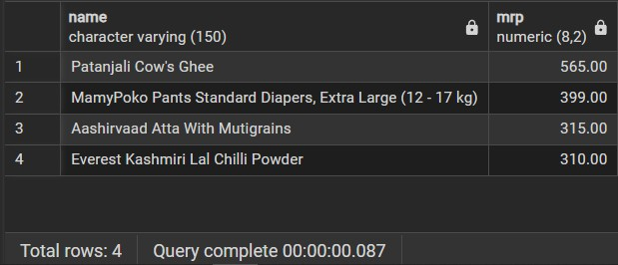
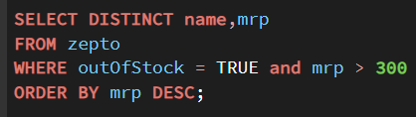
SQL Queries
High-MRP Products Out of Stock
Insights: These are high-ticket items currently unavailable — may result in lost revenue if not restocked.

Slide 9
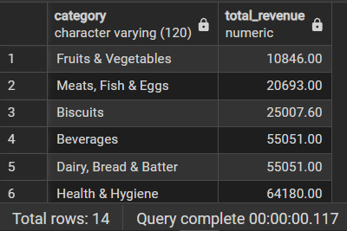
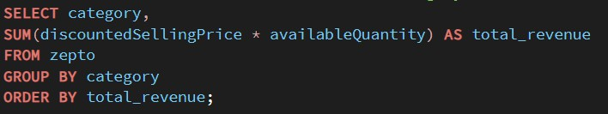
SQL Queries
Revenue by Category
Insights: Reveals top revenue-generating categories — useful for product prioritization.

Slide 10
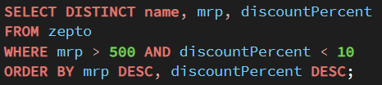
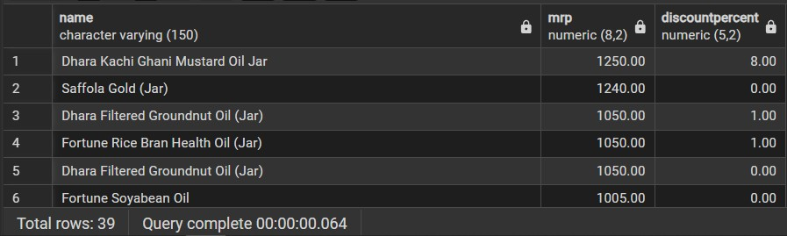
SQL Queries
Expensive Products with Low Discount
Insights:
These are premium-priced items that could benefit from promotional pricing.

Slide 11
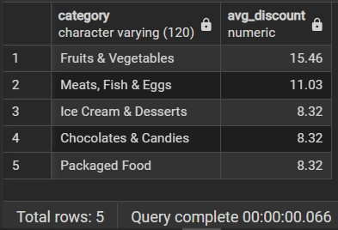
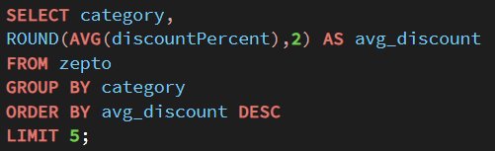
SQL Queries
Categories with Highest Average Discounts
Insights: Identifies high-discount categories — ideal for discount marketing or sales strategy.

Slide 12
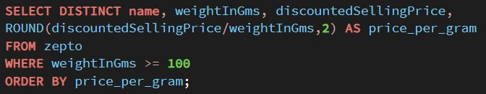
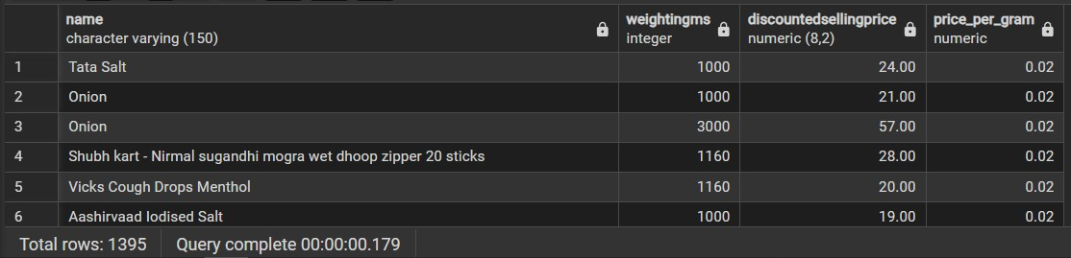
SQL Queries
Price Per Gram
Insights: Helps surface best value-for-money items in terms of quantity per ₹.

Slide 13
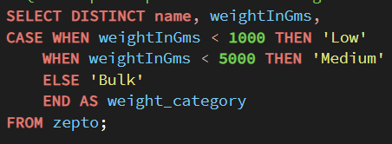
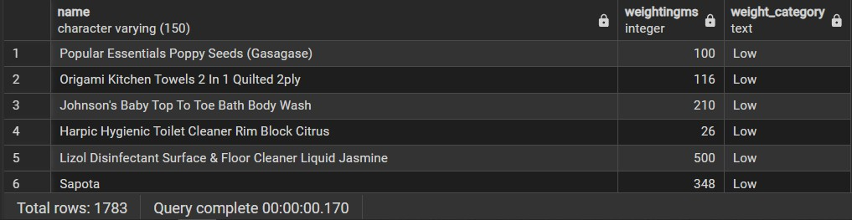
SQL Queries
Weight-Based Product Segmentation
Insights: Enables packaging strategy and inventory planning based on product size.

Slide 14


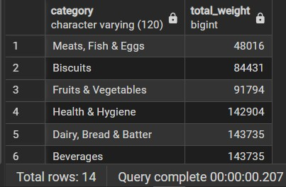
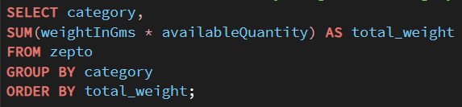


SQL Queries
Total Inventory Weight by Category
Insights: Understand physical storage demands by category — relevant for logistics and warehouse teams.

Slide 15

Business Insights from SQL
Top Discounts
Identified highest- discounted products for marketing pushes
Stock Gaps
High-MRP products out of stock = missed revenue opportunities
Revenue Trends
Category-wise revenue shows where profit concentration lies
Pricing Logic
Calculated price per gram to find value-for-money products
Weight Tiers
Products segmented into Low, Medium, Bulk for logistics use
Discount Focus
Top 5 categories with the highest average discounts

Slide 16



Challenges and Solutions
Challenges
Solutions
Encoding errors during CSV import
Zero MRP and price entries
Inconsistent units in quantity field
Repetitive product names
Saved using UTF-8 format in Excel
Filtered and deleted invalid rows
Focused analysis on weight- based insights
Used name + weight + price for uniqueness

Slide 17
Key Outcomes
Built a clean SQL database from semi-structured data
Delivered 8+ business-driven queries with actionable results
Simulated real analyst workflows: import → clean → analyze → present
4. Gained deep insight into inventory strategy, pricing, and availability

Slide 18
Conclusion
Demonstrated the power of SQL in analyzing e-commerce inventory
Addressed real-world data issues and extracted business insights
Perfect showcase project for aspiring Data Analysts
Flexible for expansion into dashboards, NLP, and Python
analysis

Slide 19

Thank You
"From Raw Data to Real Impact – Turning Inventory into Insights"
charkamaheshmahi@gmail.com

